Slide 1
Book My Show Clone

Slide 2
Intro
Book My Show is a popular website used for booking movie tickets.
As part of the assignment provided. A clone of Book My Show has been made.
The project used React, Dotnet and SQL Server.

Slide 3
Database

Slide 4
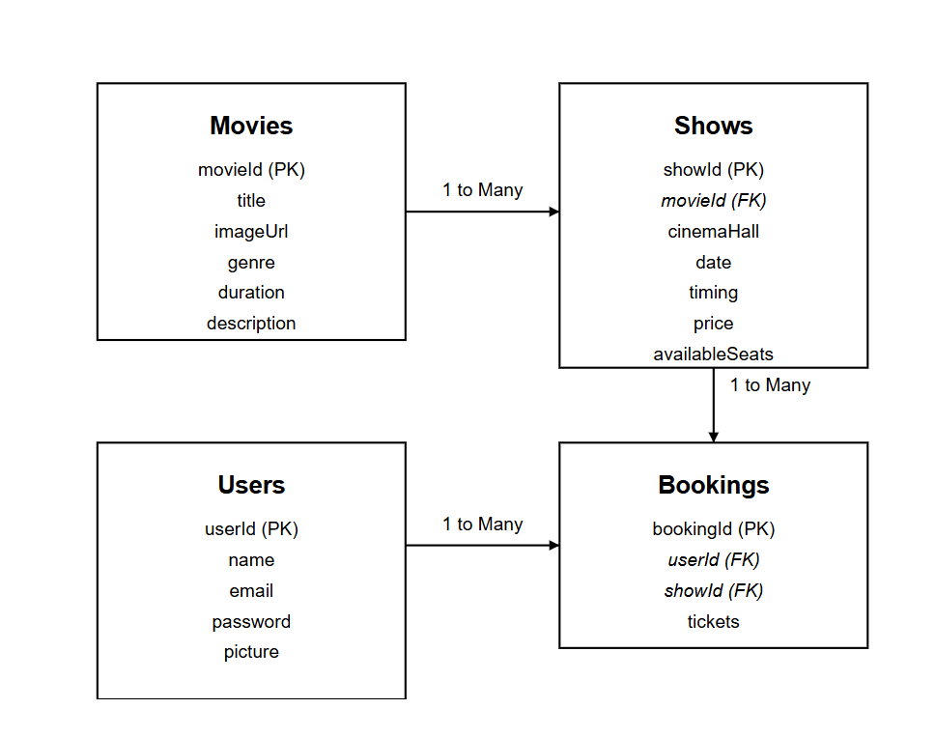
ER Diagram

Slide 5
MovieList table
Column | Type | Constraints
movieId | INT | PRIMARY KEY
title | VARCHAR | NOT NULL
imageUrl | VARCHAR | NOT NULL
genre | VARCHAR | CHECK IN (Anime, Horror, Sci-Fi, RomCom)
duration | INT | NOT NULL
description | TEXT | NOT NULL

Slide 6
ShowsList Table
Column | Type | Constraints
showId | INT | PRIMARY KEY
movieId | INT | FOREIGN KEY -> Movies
cinemaHall | VARCHAR | NOT NULL
date | DATE | NOT NULL
timing | VARCHAR | NOT NULL
price | INT | NOT NULL
availableSeats | INT | NOT NULL

Slide 7
BookingList Table
Column | Type | Constraints
bookingId | INT | PRIMARY KEY
userId | INT | FOREIGN KEY -> Users
showId | INT | FOREIGN KEY -> Shows
tickets | INT | NOT NULL

Slide 8
UsersList Table
Column | Type | Constraints
userId | INT | PRIMARY KEY
name | VARCHAR | NOT NULL
email | VARCHAR | NOT NULL
password | VARCHAR | NOT NULL
picture | VARCHAR | NOT REQUIRED
isAdmin | BOOL | NOT NULL

Slide 9
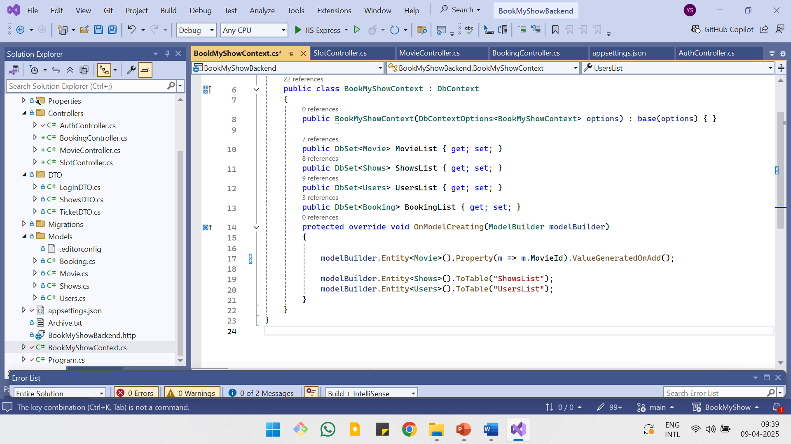
Database Context
The Models are mapped with variables as:
Movie | MovieList
Shows | ShowsList
Users | UsersList
Booking | BookingList

Slide 10
Backend

Slide 11
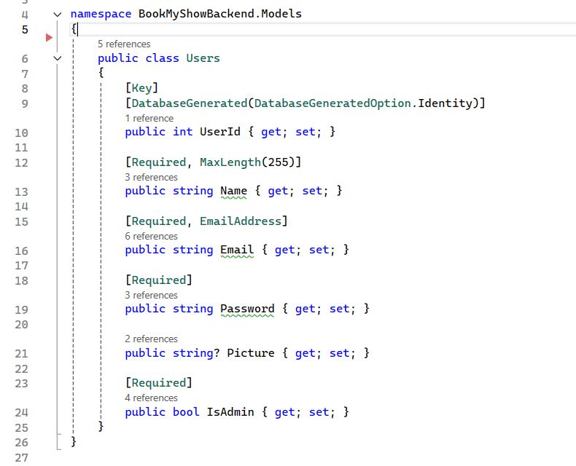
Users Model

Slide 12
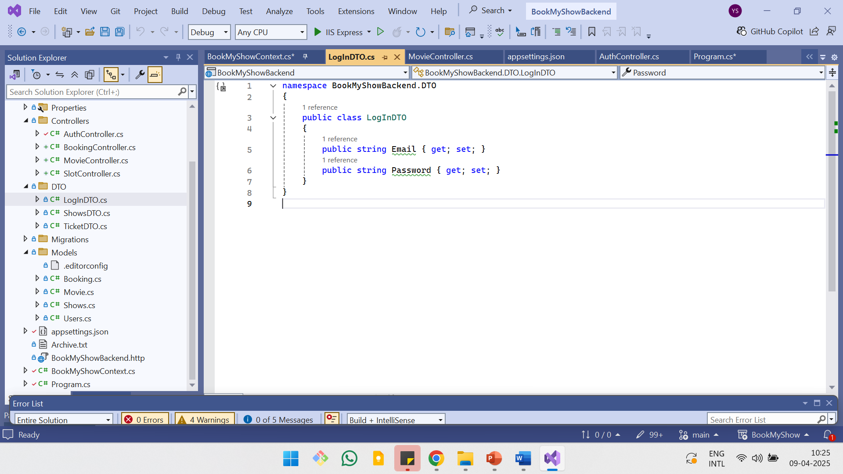
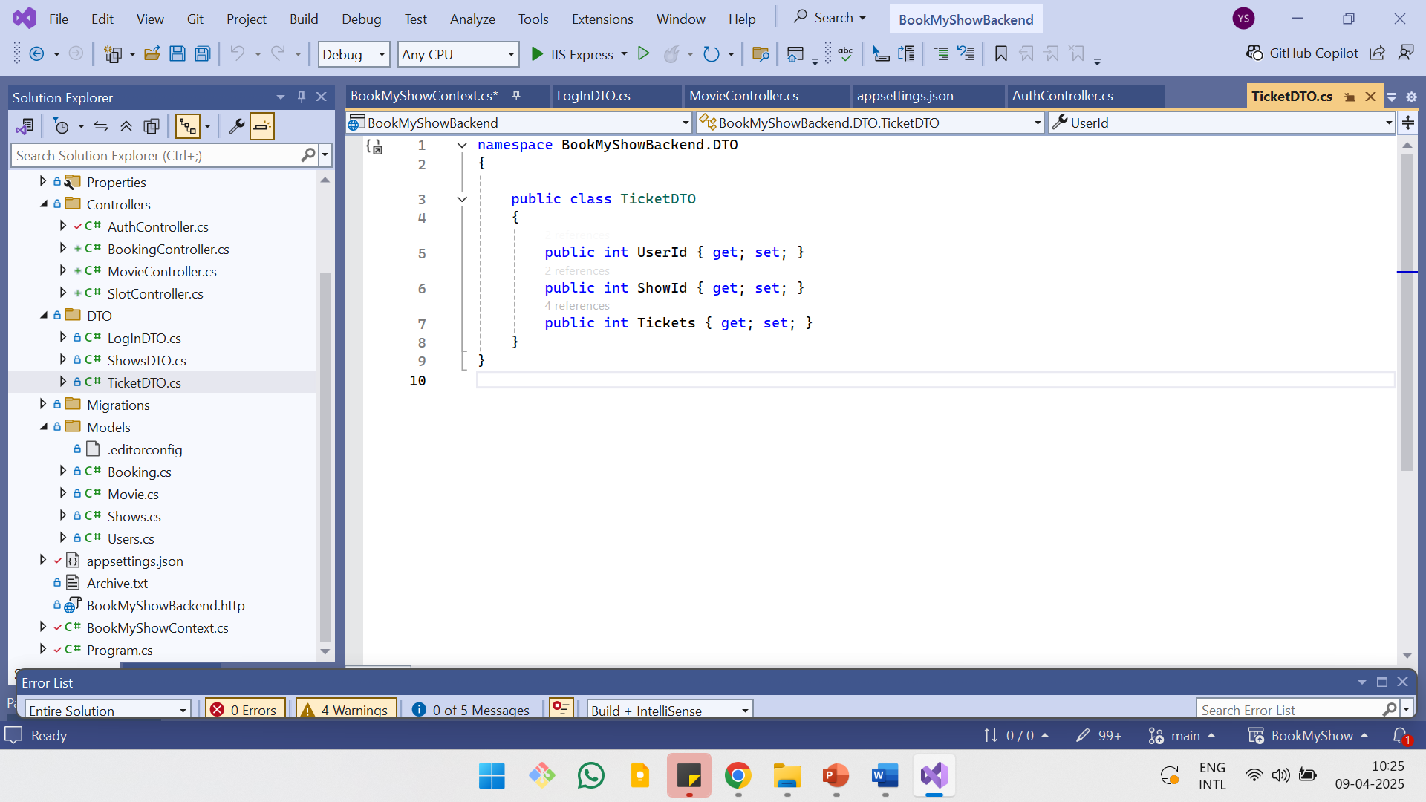
DTO

Slide 13
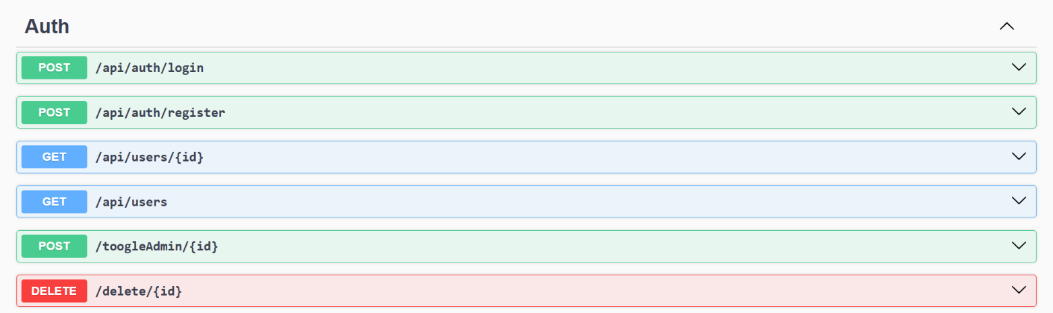
Overview: Authentication APIs

Slide 14
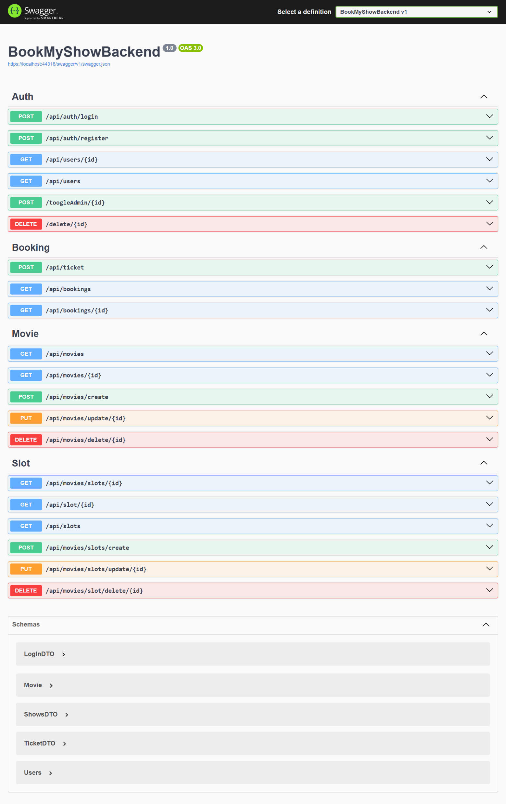
Overview: Movie and Slot APIs

Slide 15
Overview: Booking APIs

Slide 16
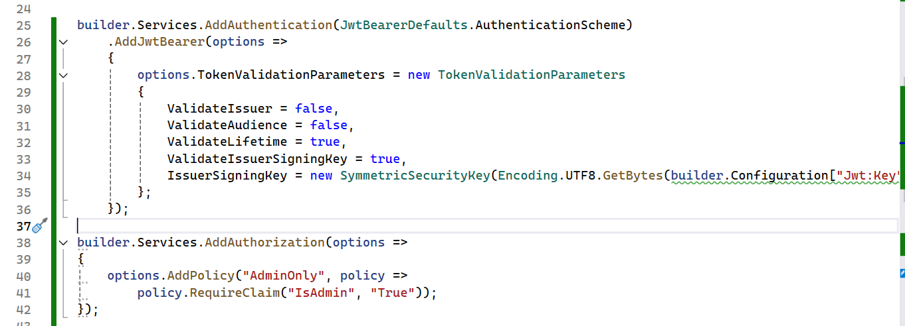
Securing Endpoints and Policy Based Authorization

Slide 17
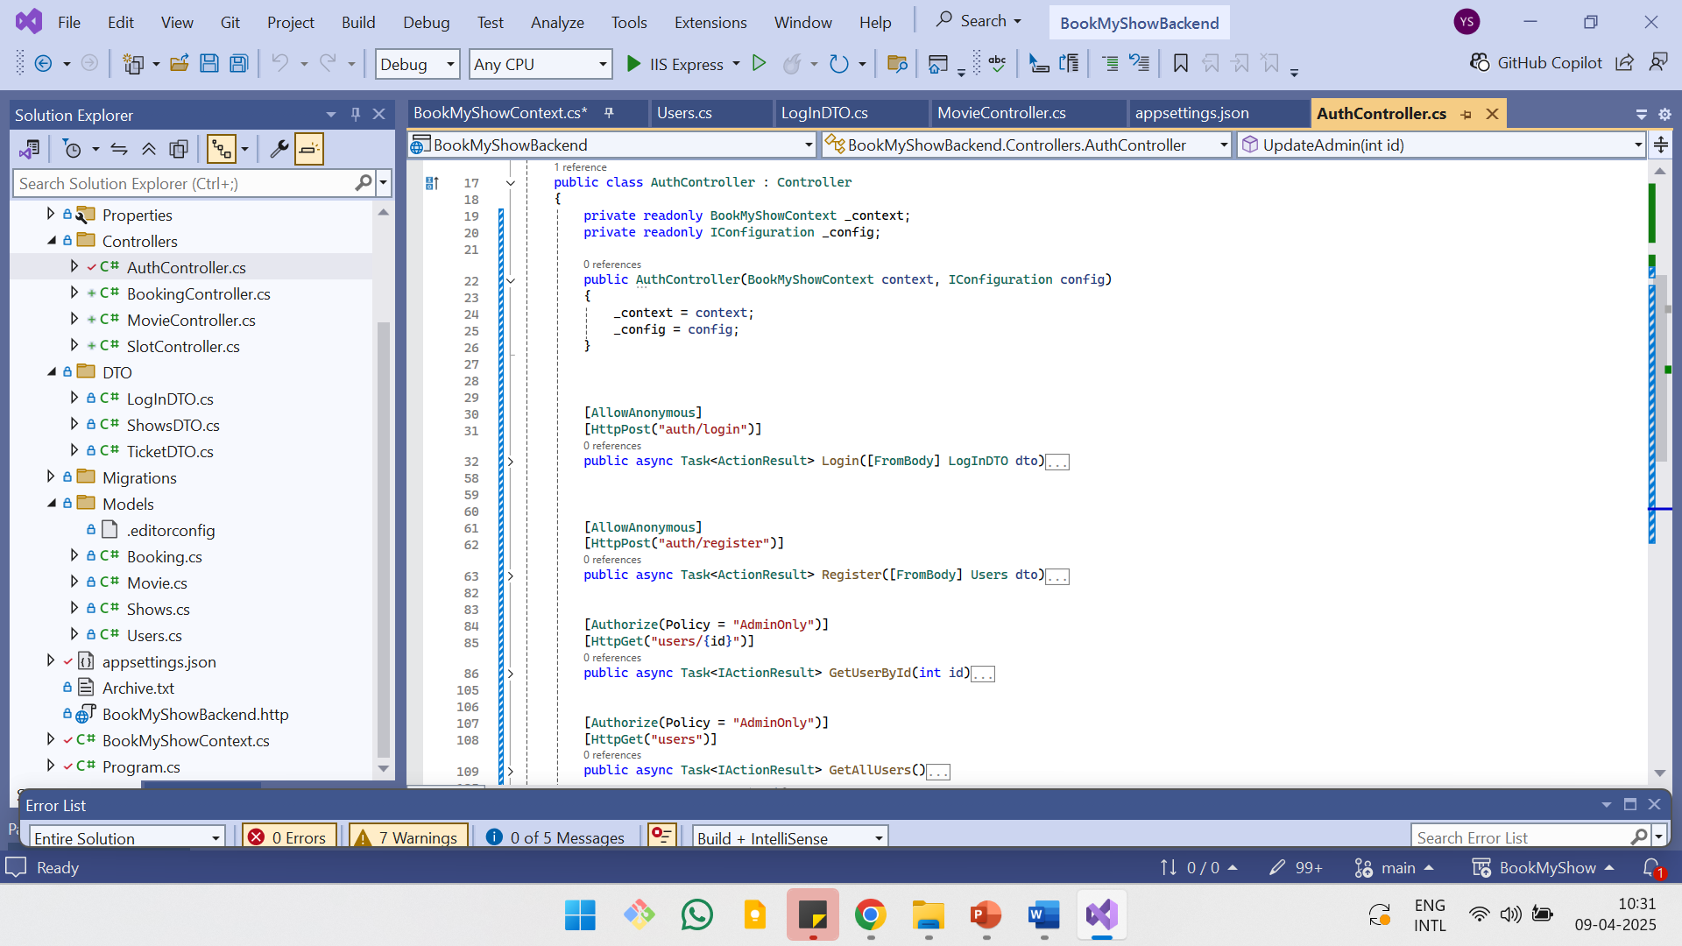
Authorization in API

Slide 18
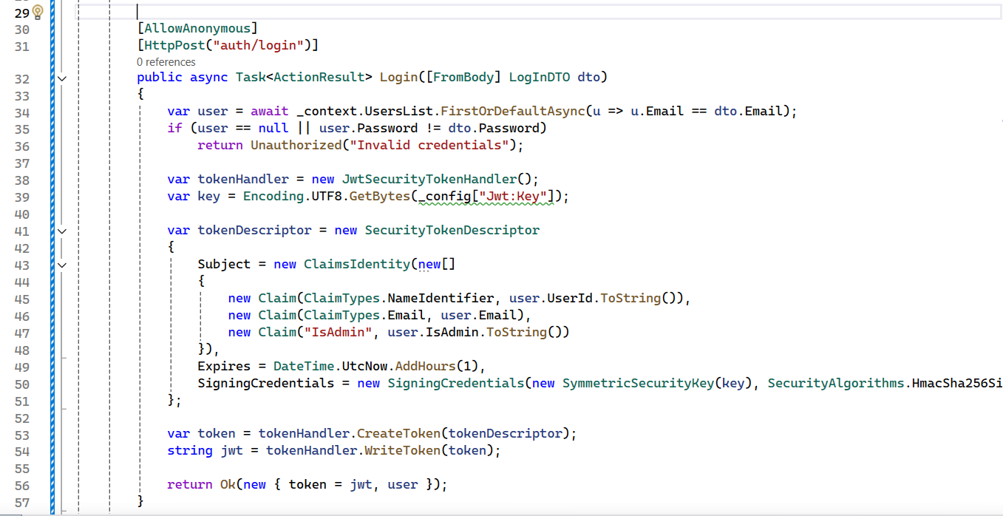
Authentication in API

Slide 19
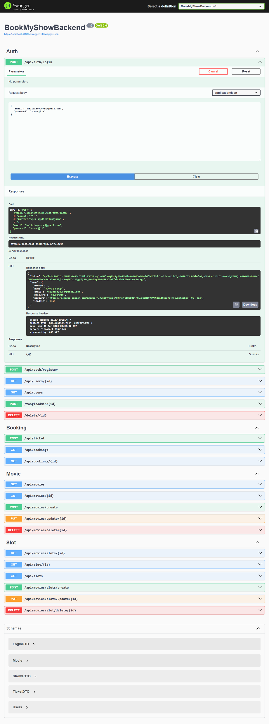
JWT

Slide 21
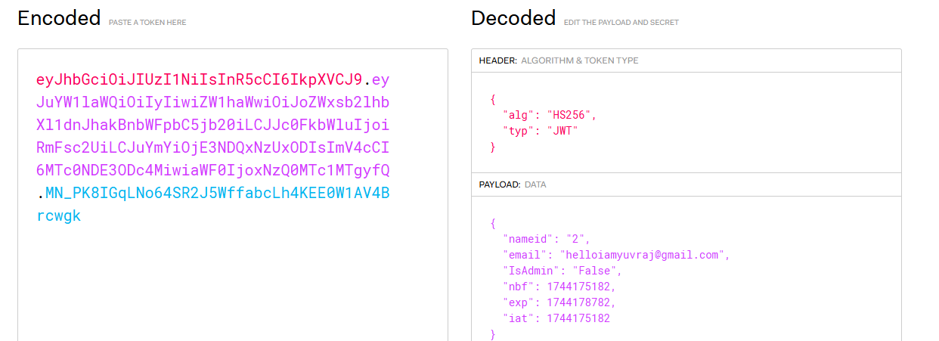
Decoding of JWT

Slide 22
Frontend

Slide 23
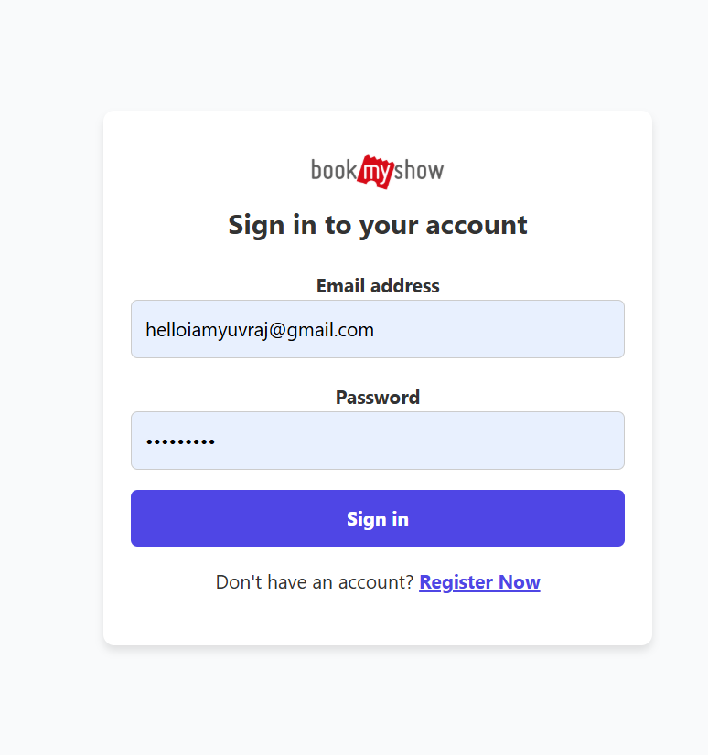
LogIn

Slide 24
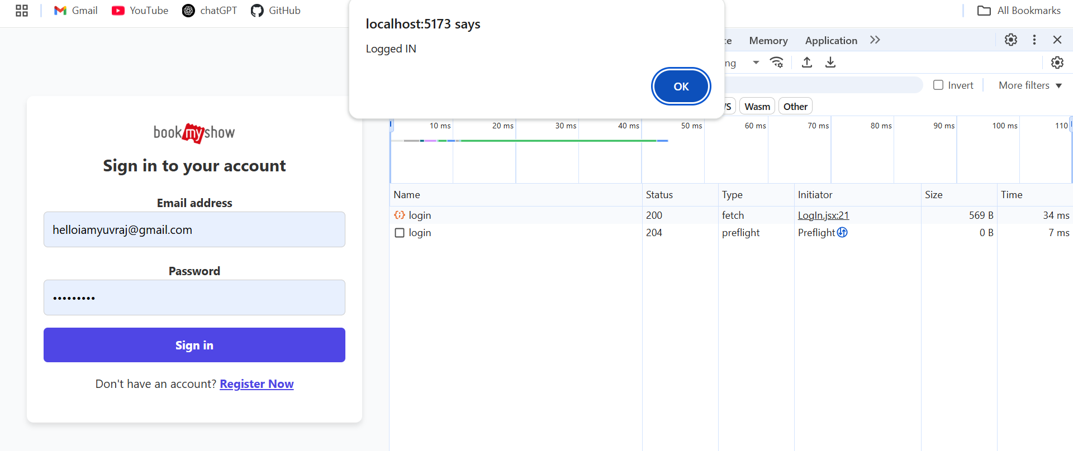
Inspect: LogIn

Slide 25
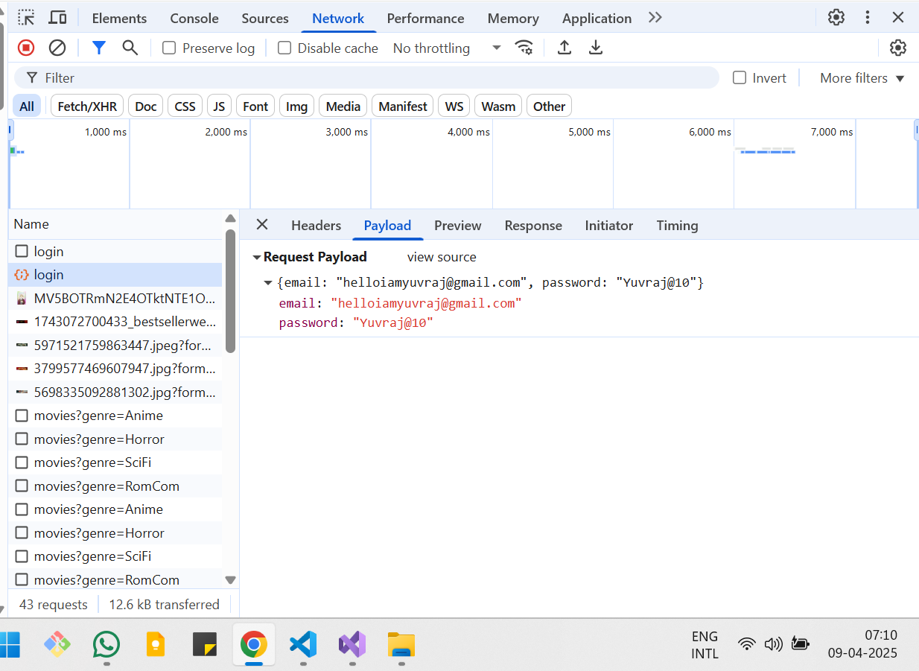
LogIn Payload

Slide 26
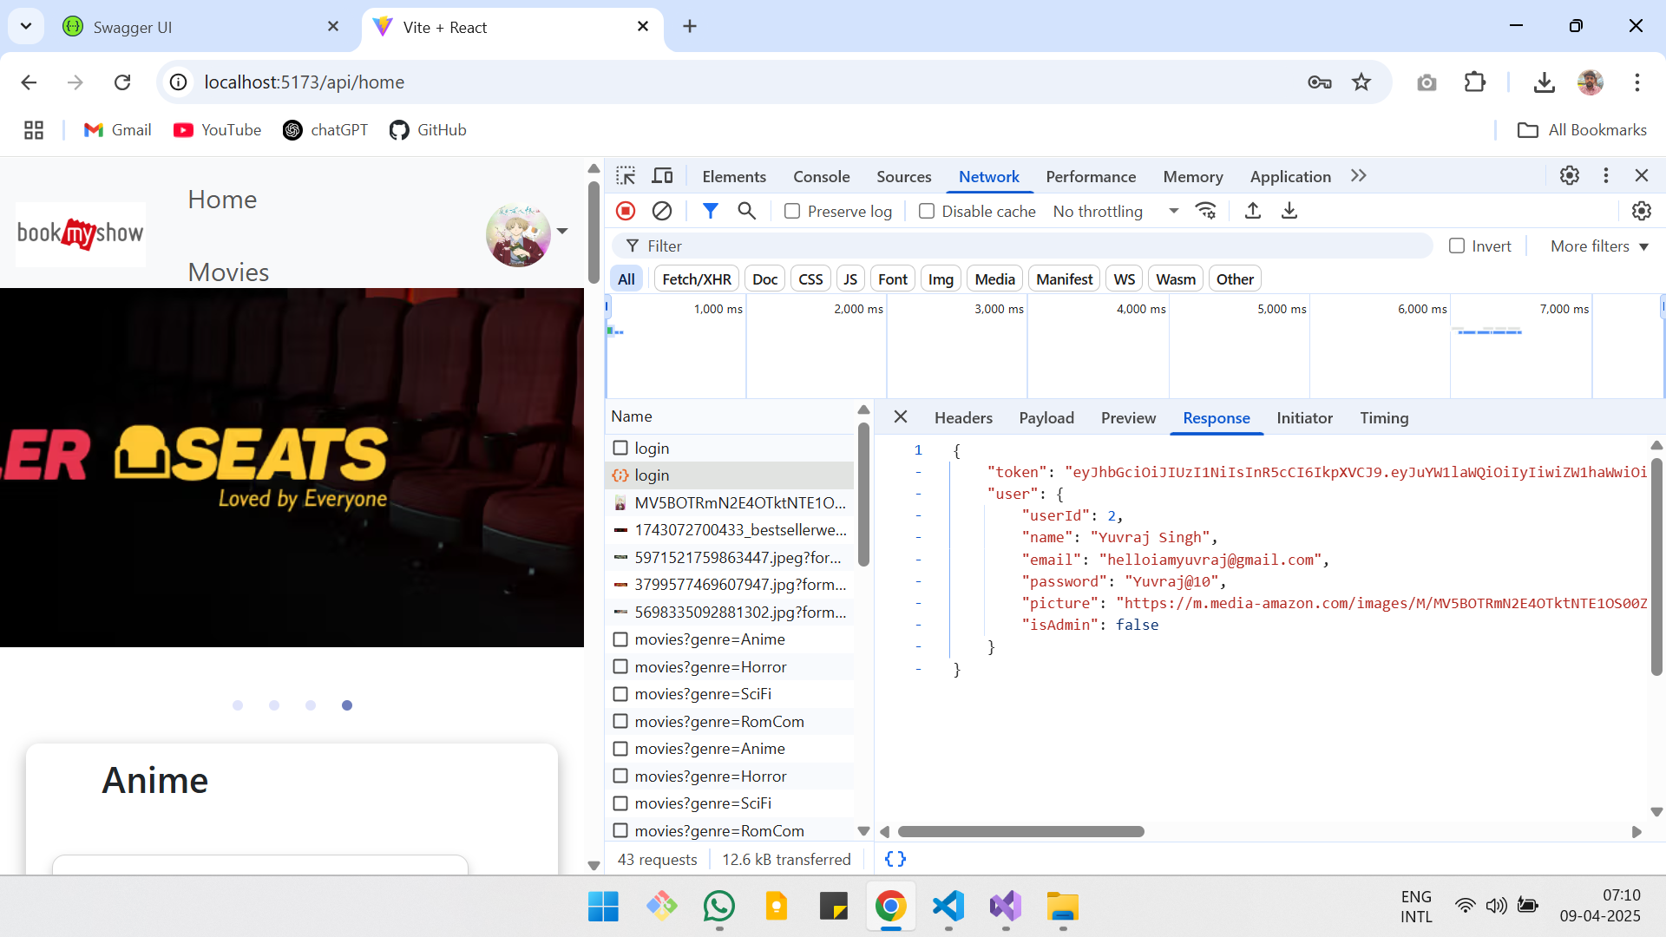
LogIn Response

Slide 27
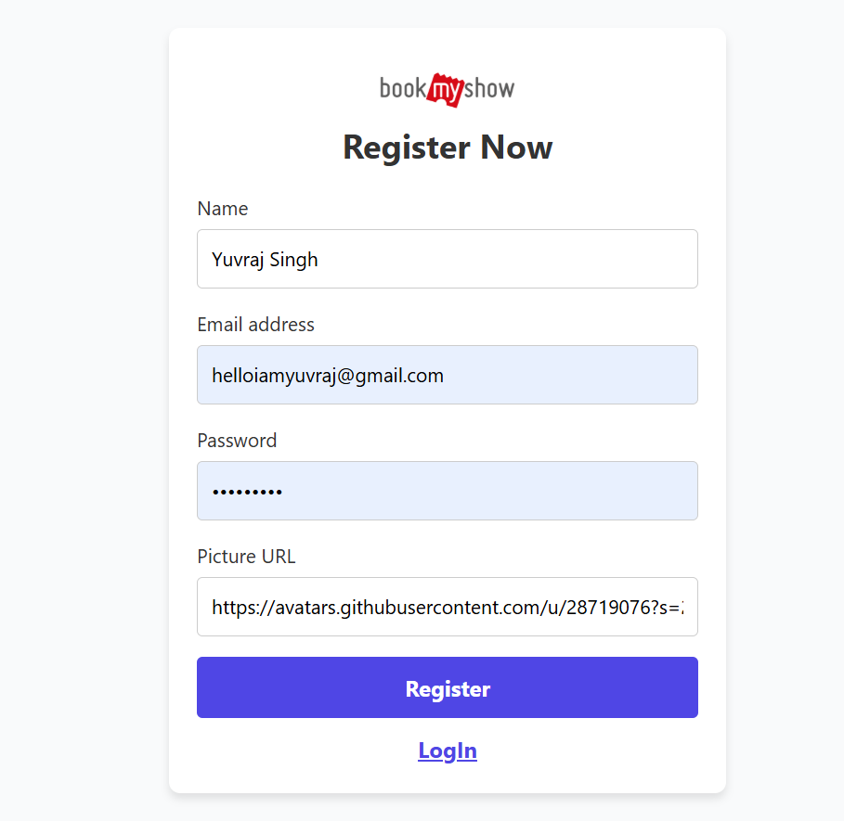
Register Page

Slide 28
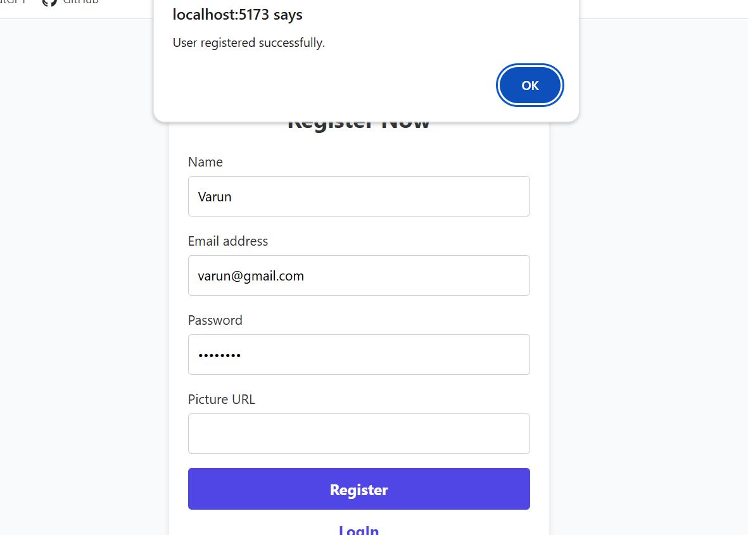
Register successful

Slide 29
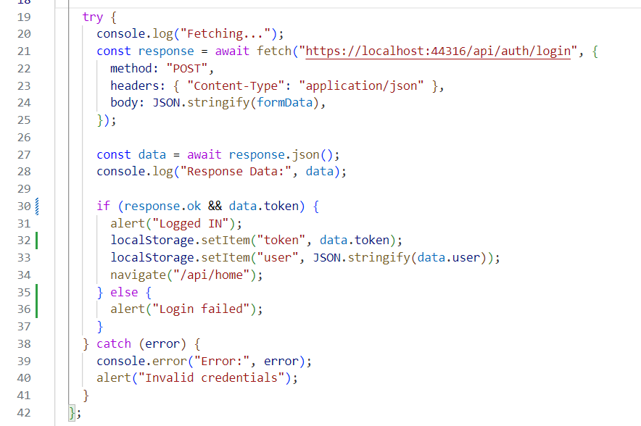
Authentication Code

Slide 30
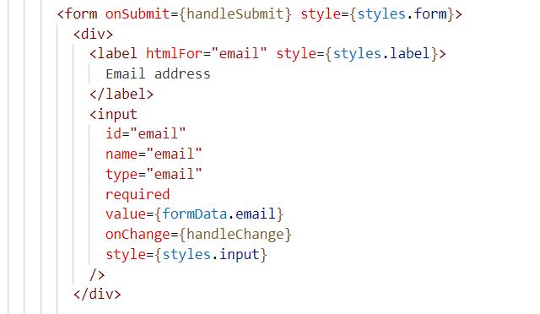

Slide 31
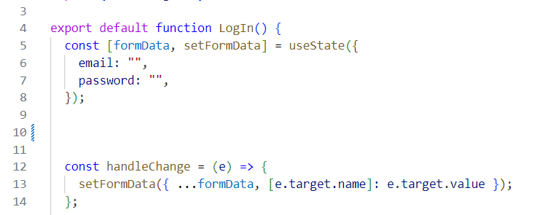

Slide 32
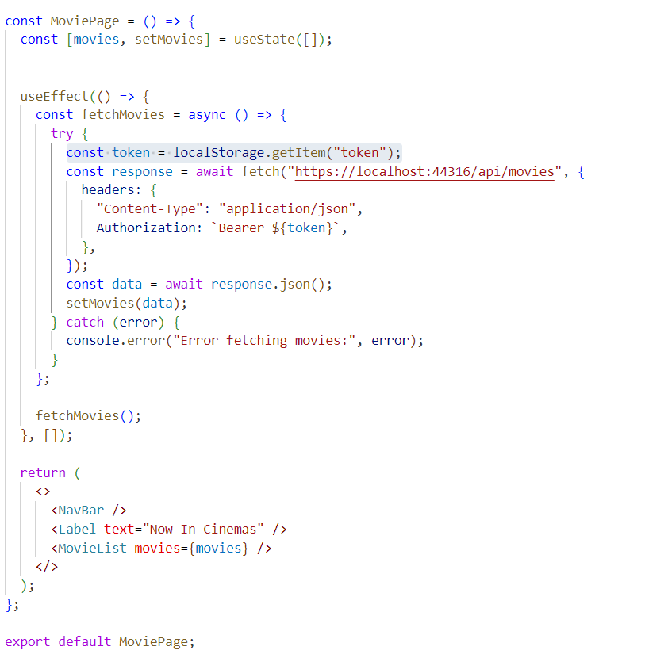
Fetching an API

Slide 33
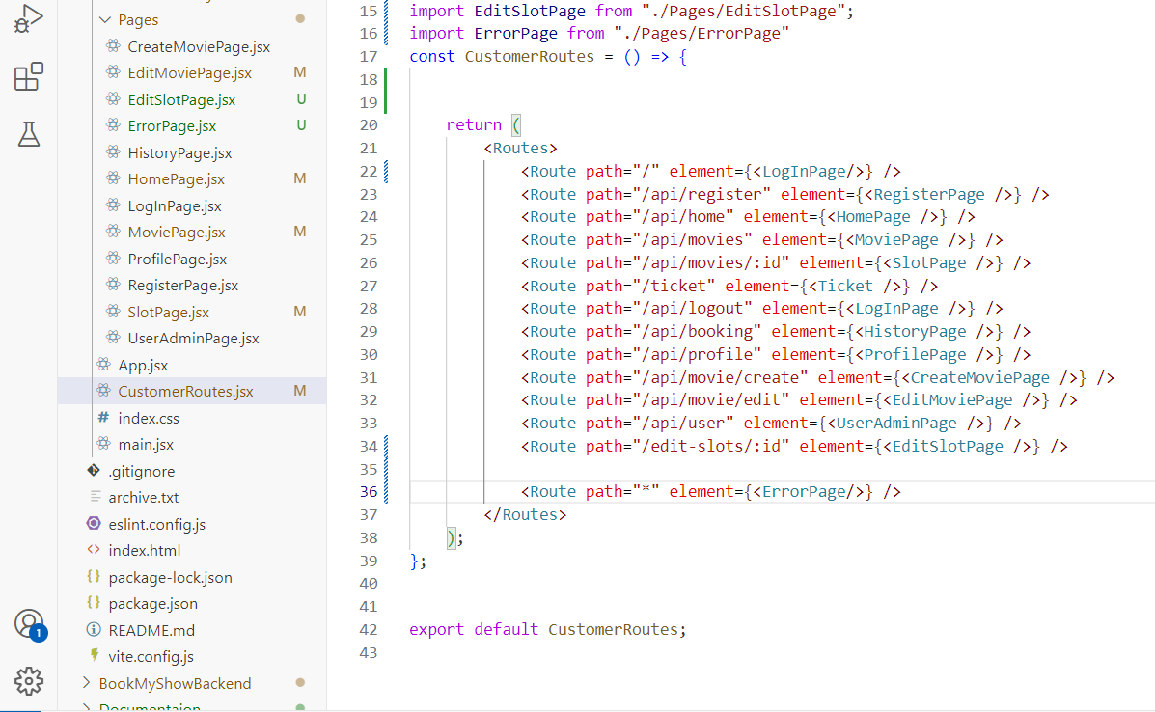
Routes

Slide 34
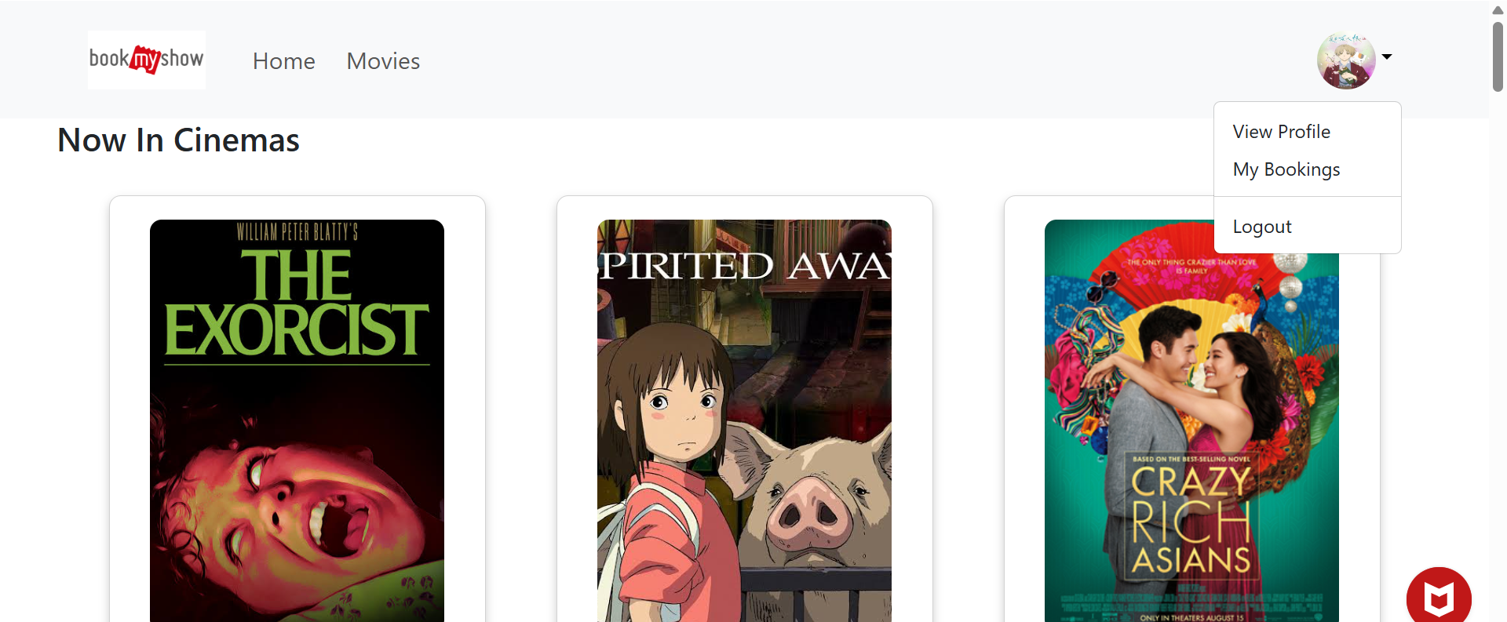
Home Page

Slide 35
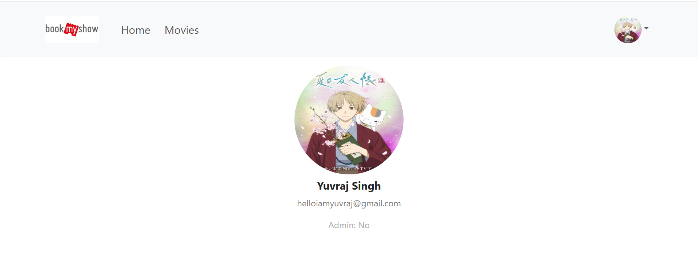
Profile Page
Componants:
NavBar
ProfileData

Slide 36
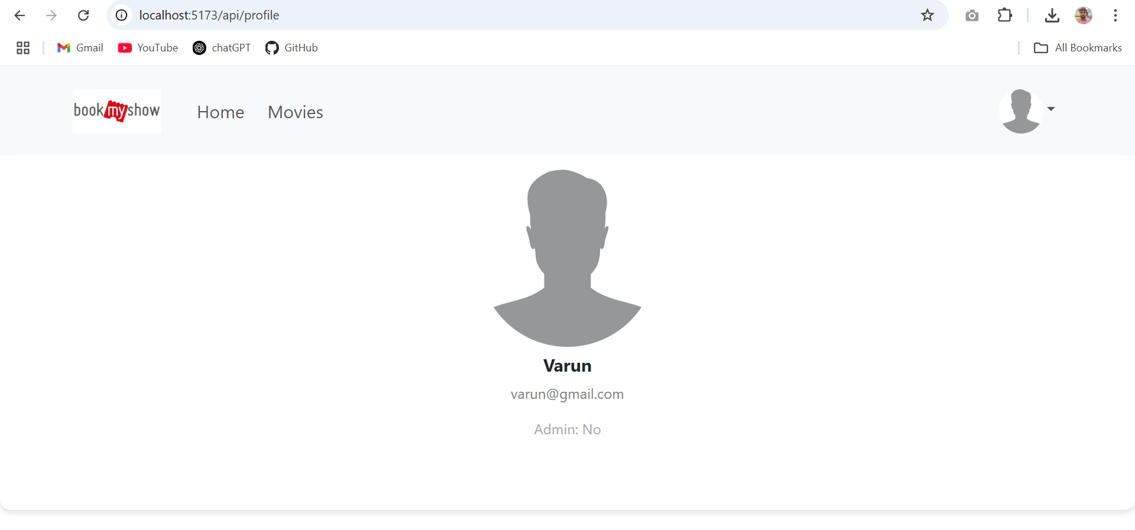
User without Profile Picture

Slide 37
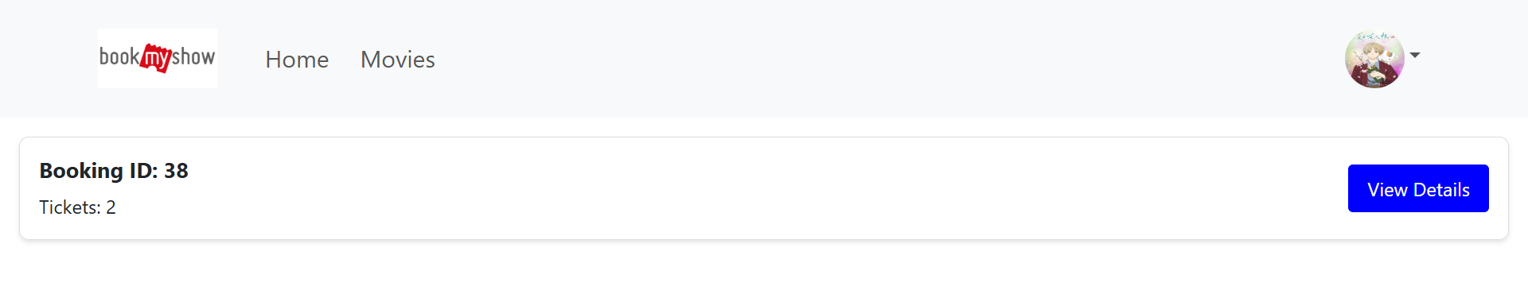
Booking History
Componants:
NavBar
BookingList
BookingCard

Slide 38
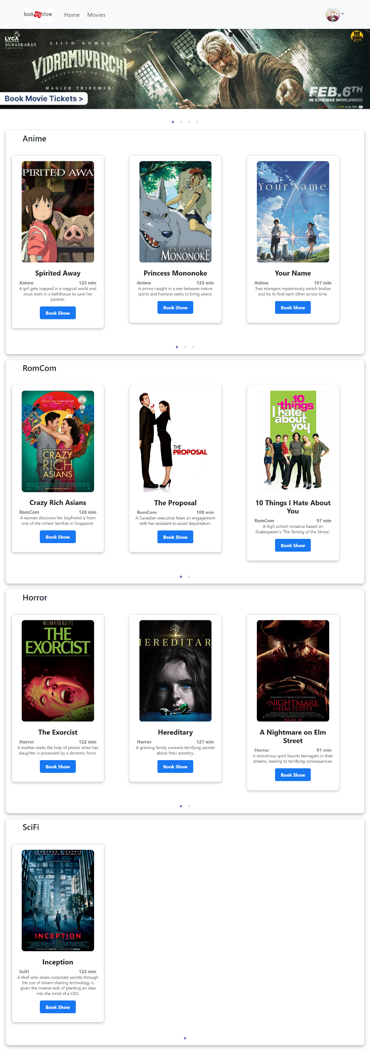
Home page
Componants:
NavBar
Carousel
MovieCardList
MovieCard

Slide 39
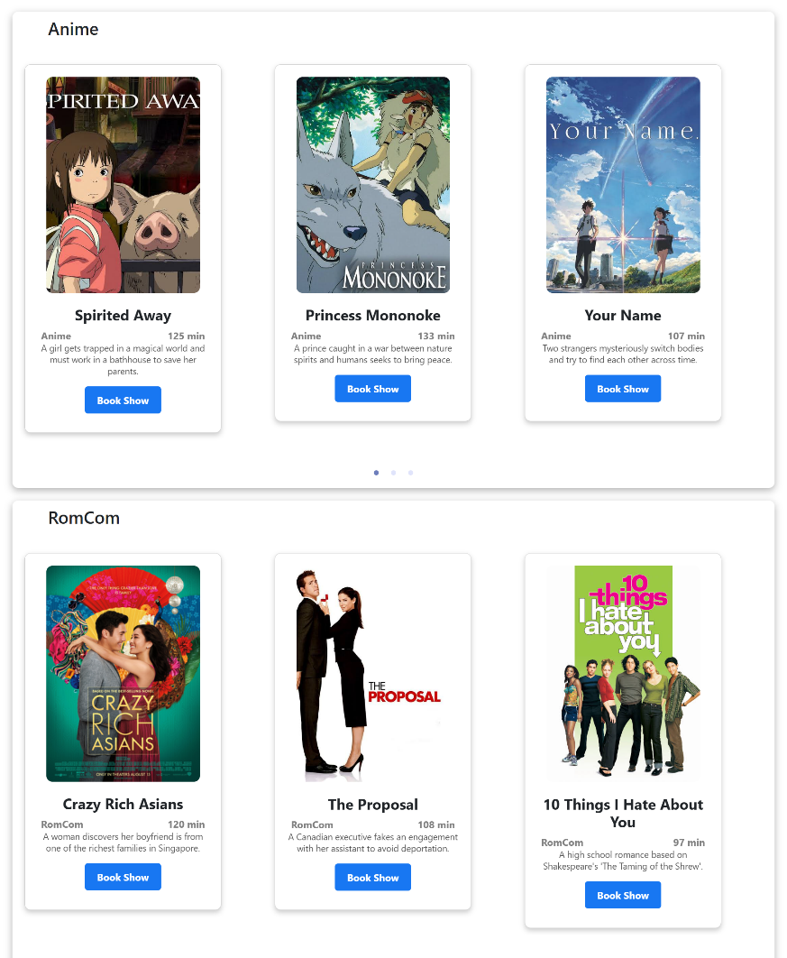
Home Page

Slide 40
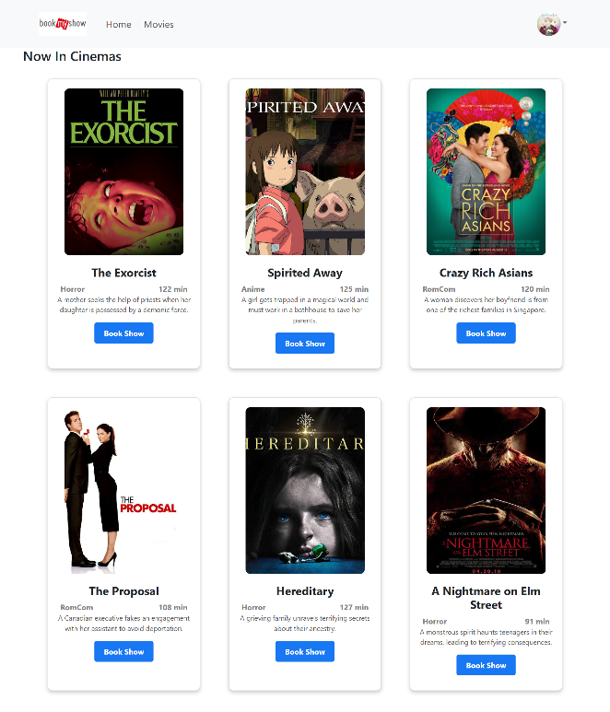
Movies Page
Componants:
NavBar
MovieCardList
MovieCard

Slide 41
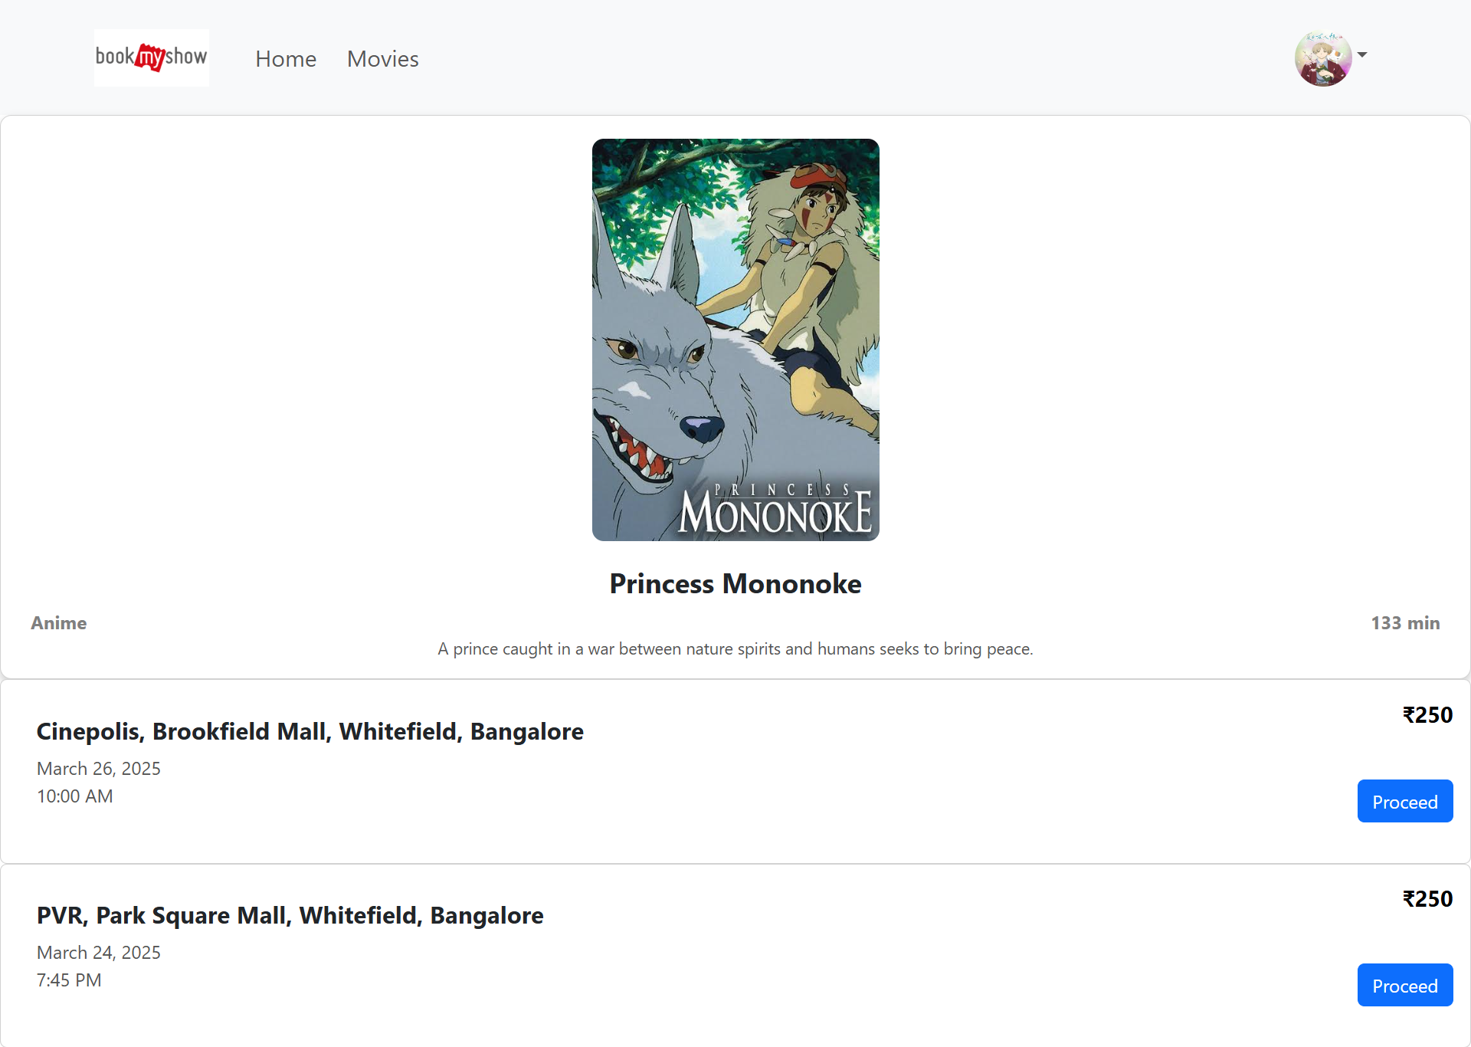
Slot page
Componants:
NavBar
MovieInfoCard
SlotList
Slot

Slide 42
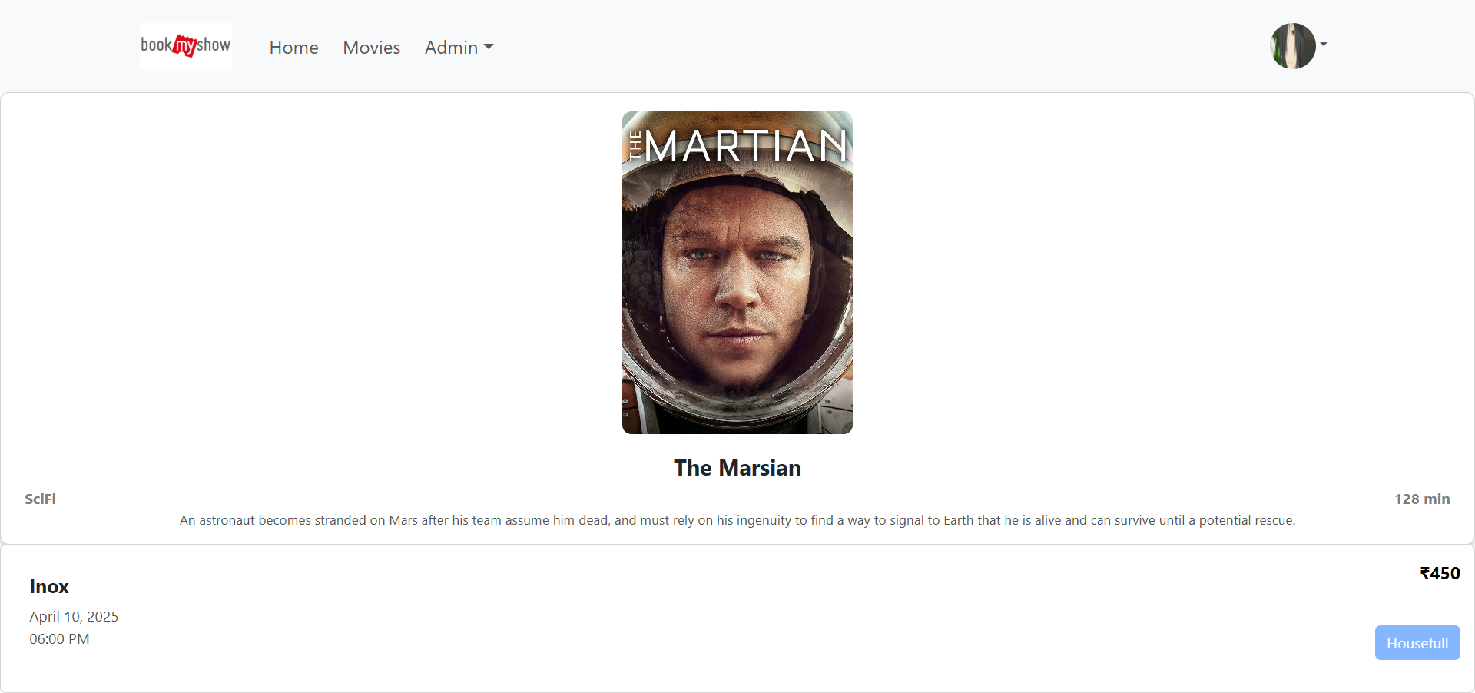
When 0 seats are available

Slide 43
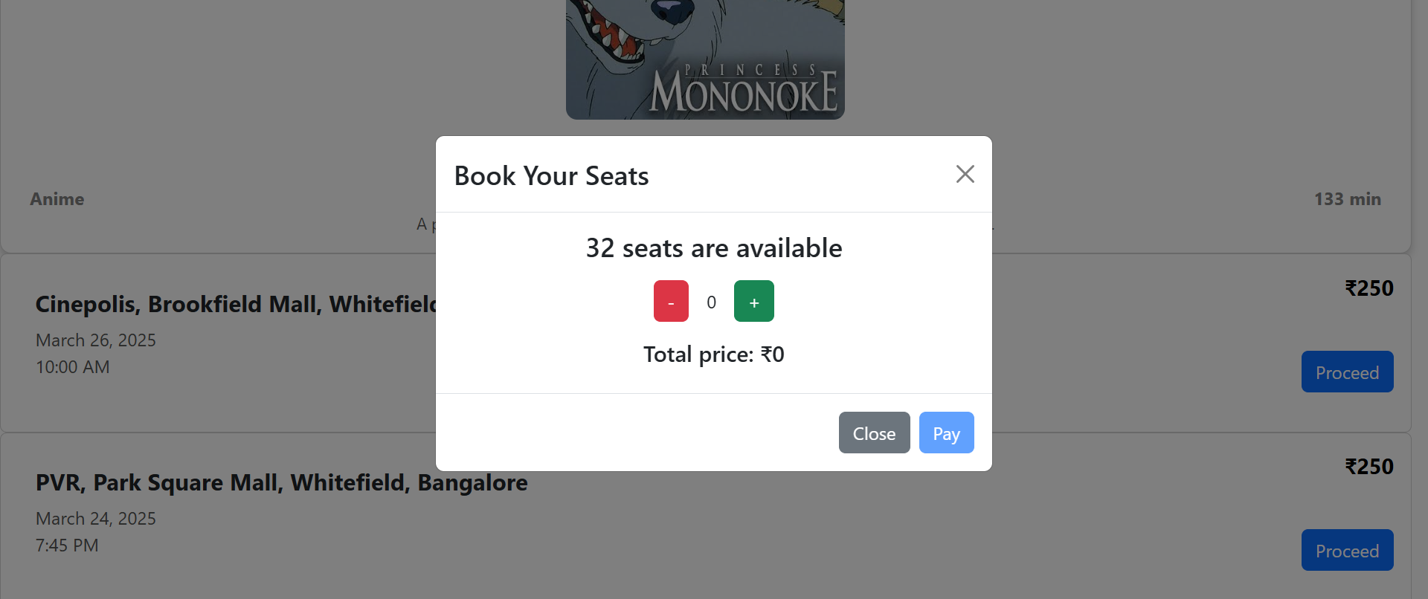
Seat Page

Slide 44
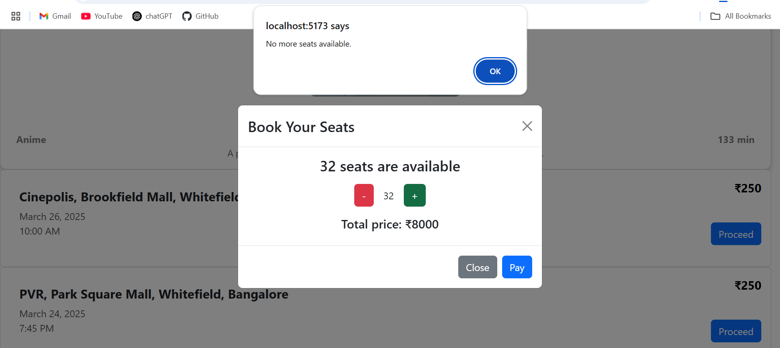
Seats not available

Slide 45
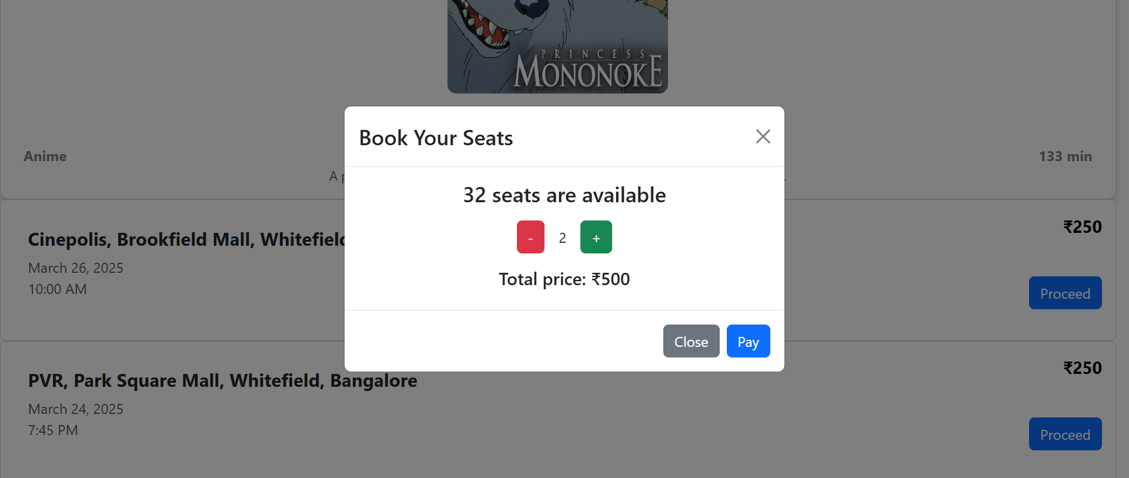
Booking seats

Slide 46
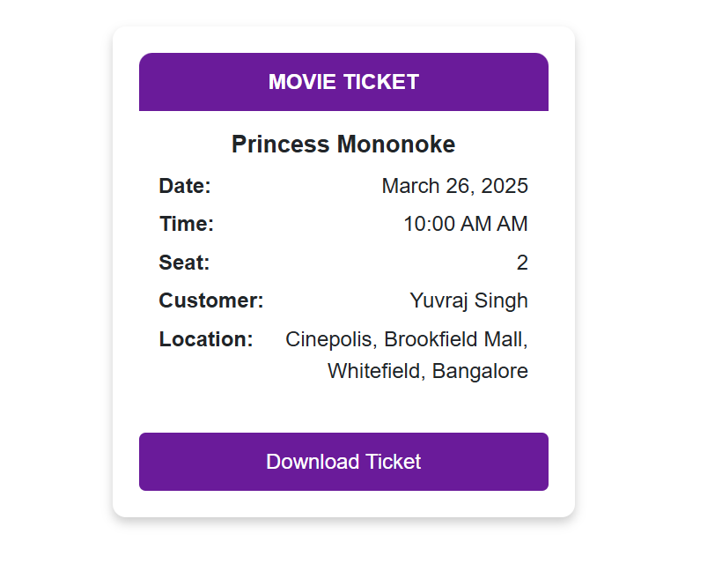
Ticket
Html2canvas
jsPDF

Slide 47
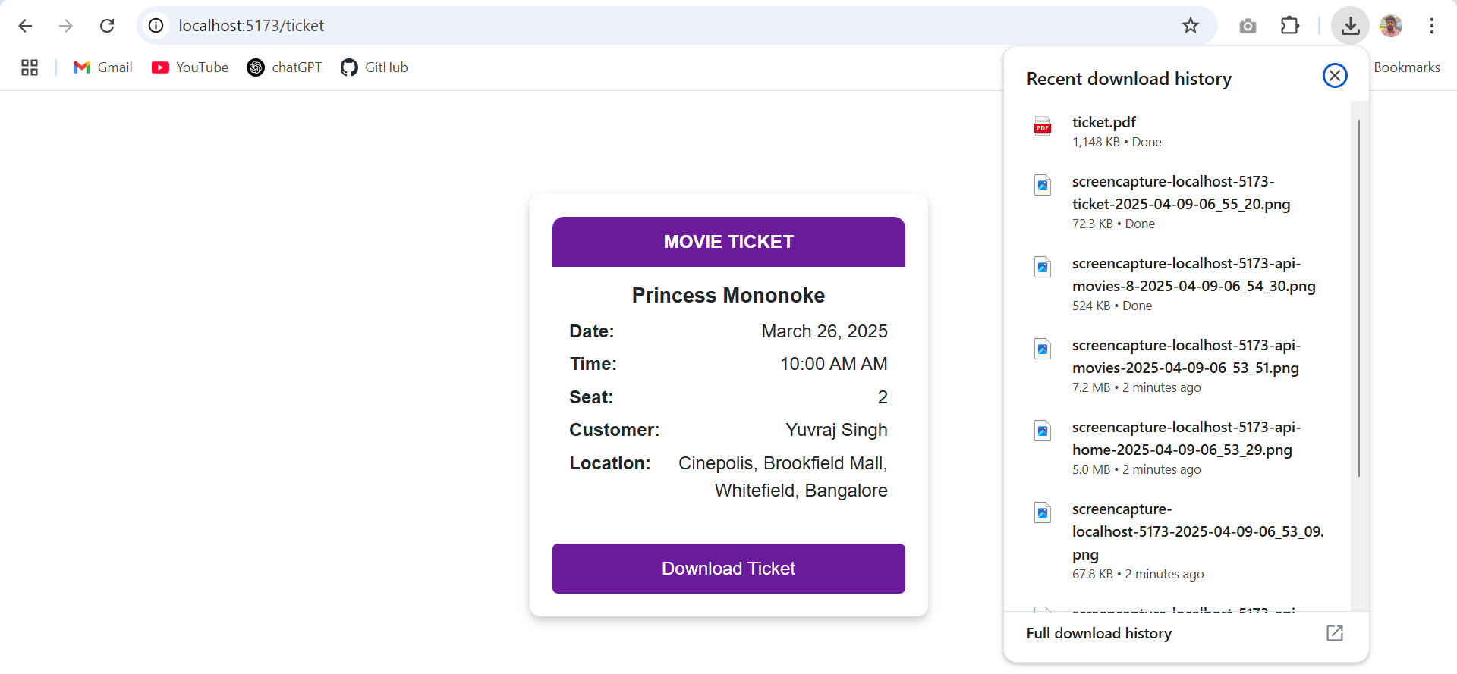
Downloading Ticket

Slide 48
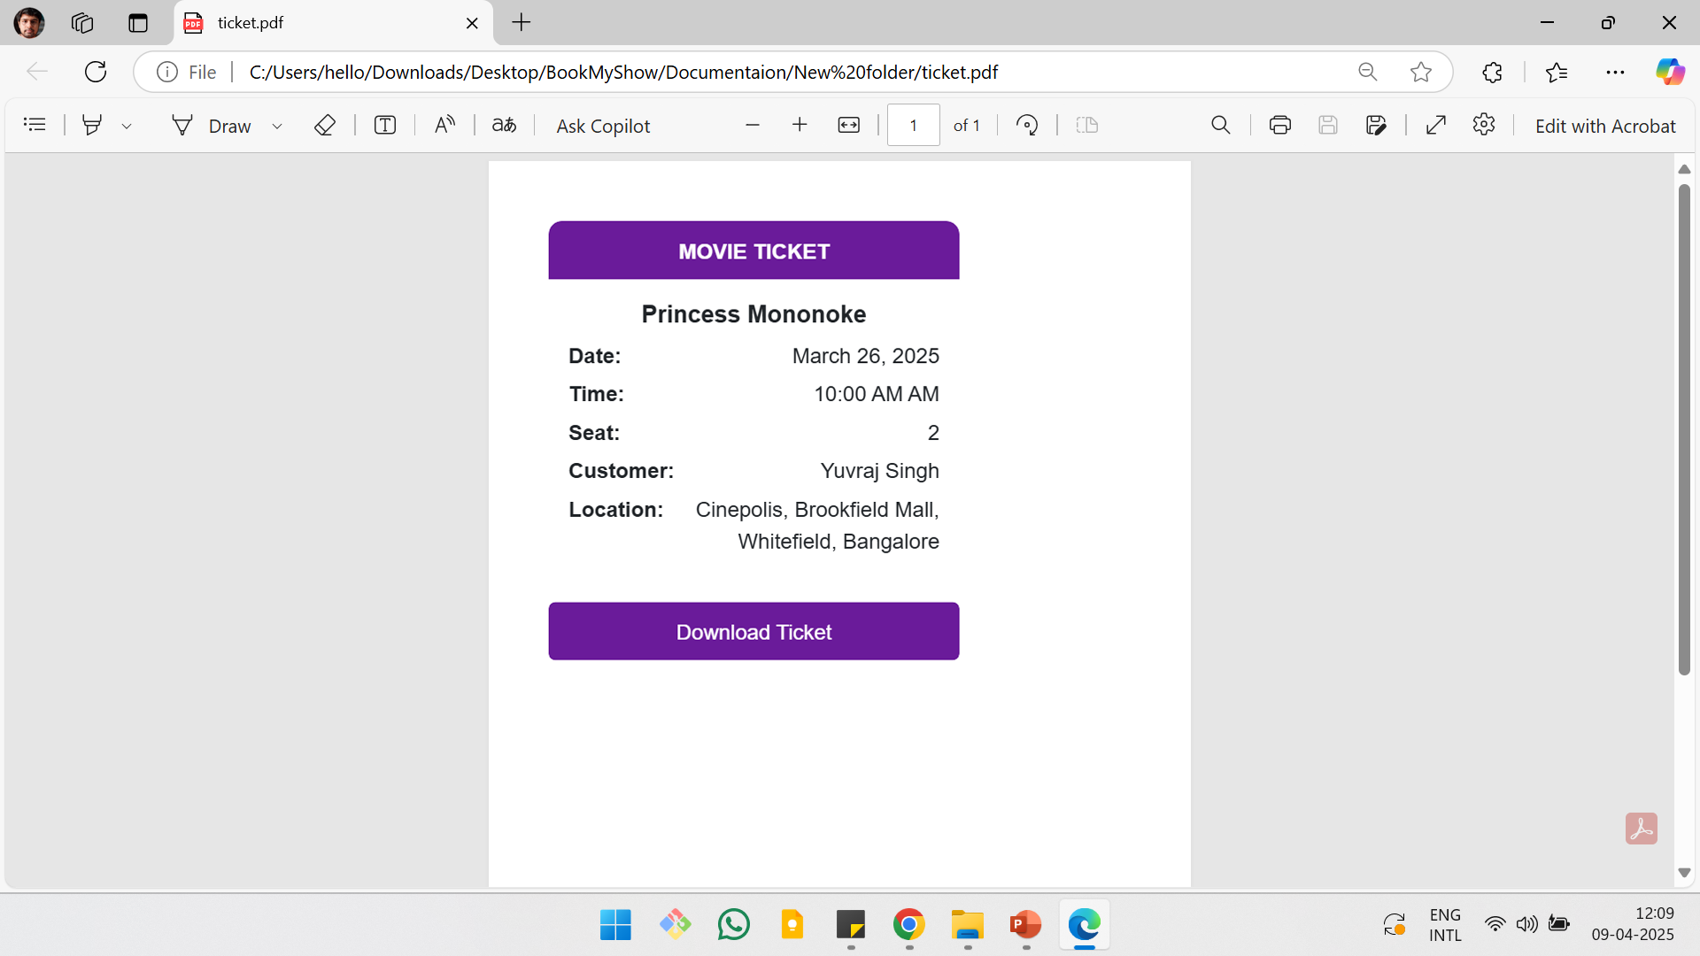
Ticket.pdf

Slide 49
Admin Control

Slide 50
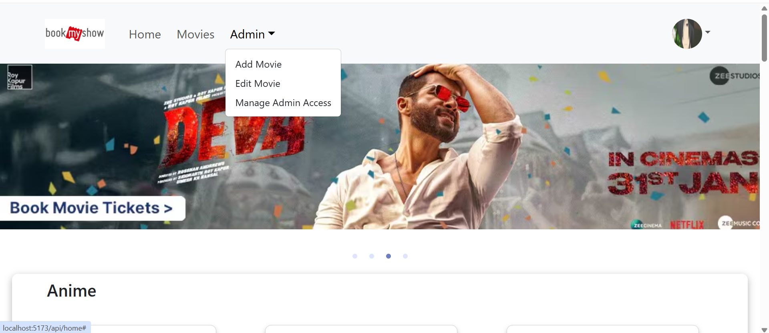
Admin Page

Slide 51
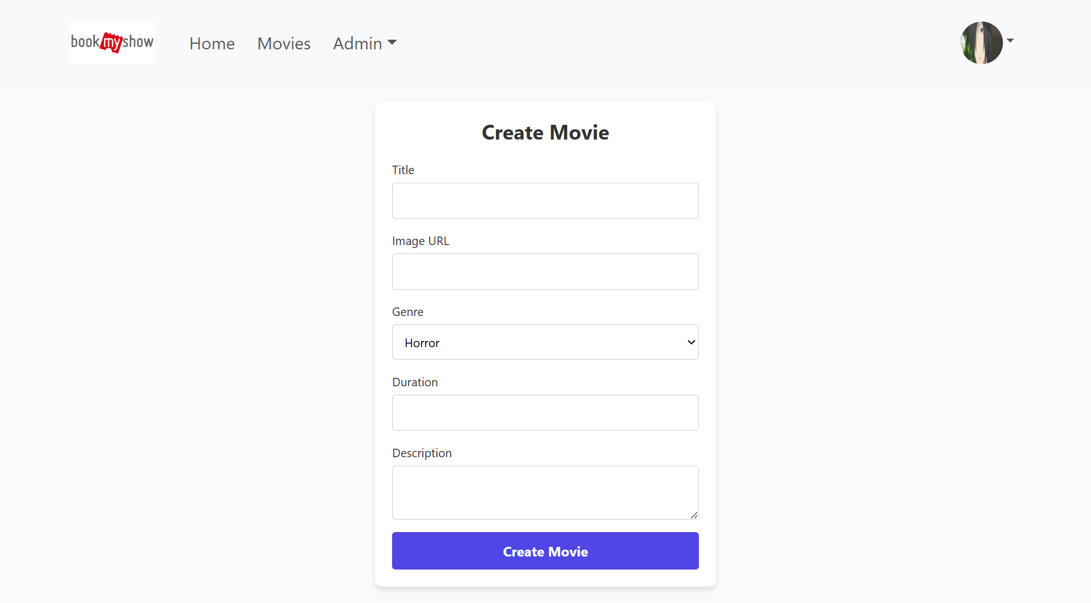
Create Movie

Slide 52
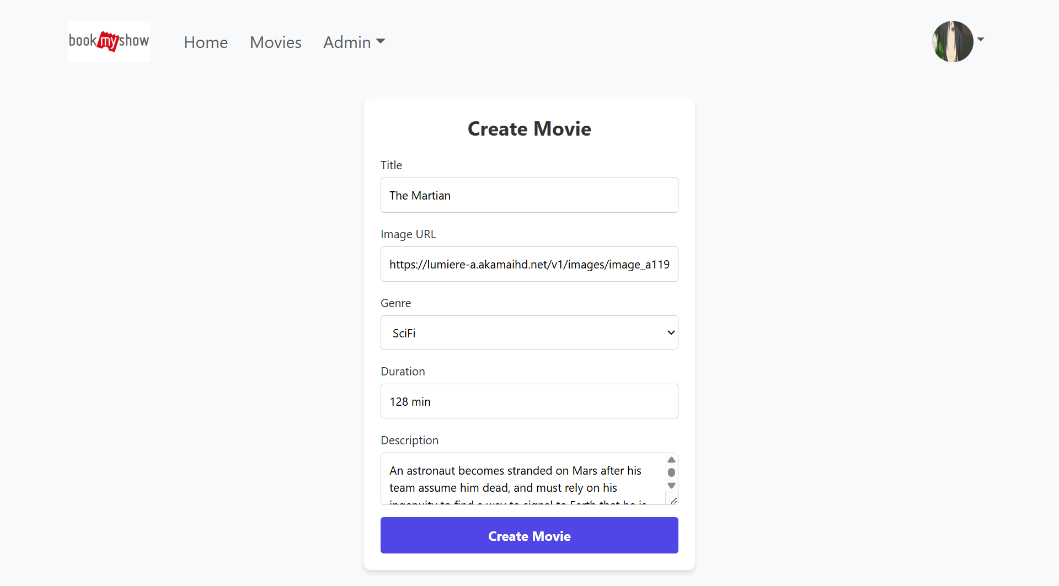

Slide 53
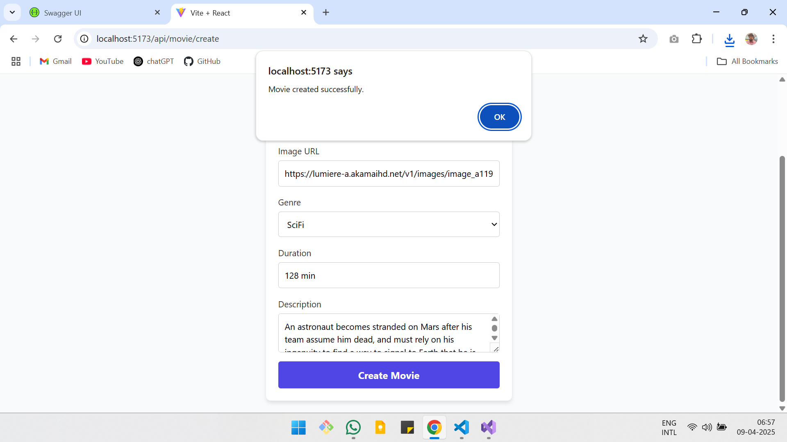

Slide 54
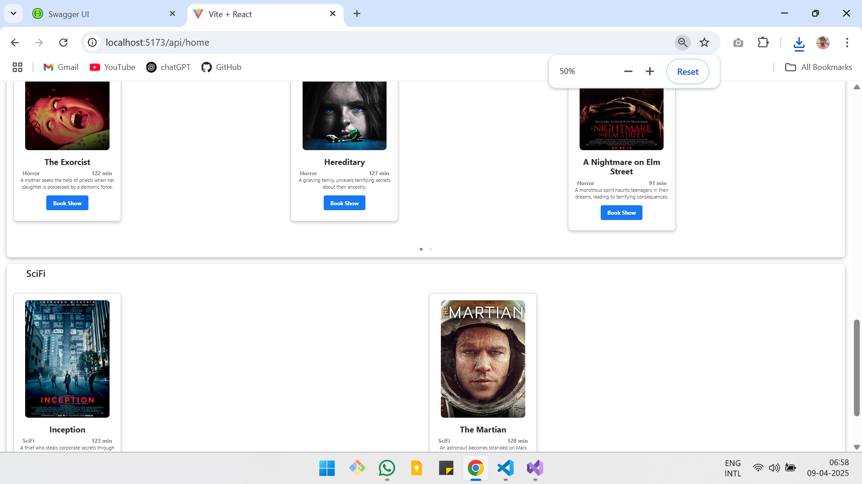
Movie Added to Home

Slide 55
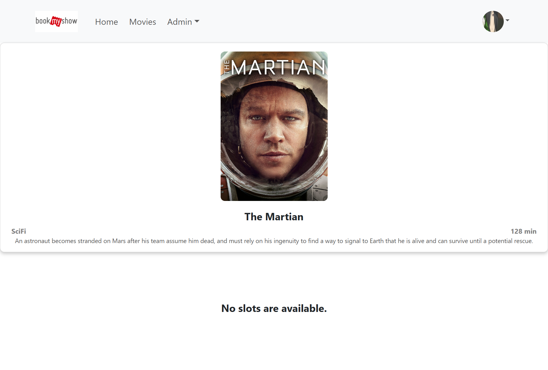
Movie without slot

Slide 56
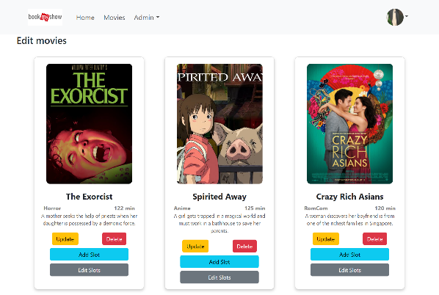
Edit Page

Slide 57
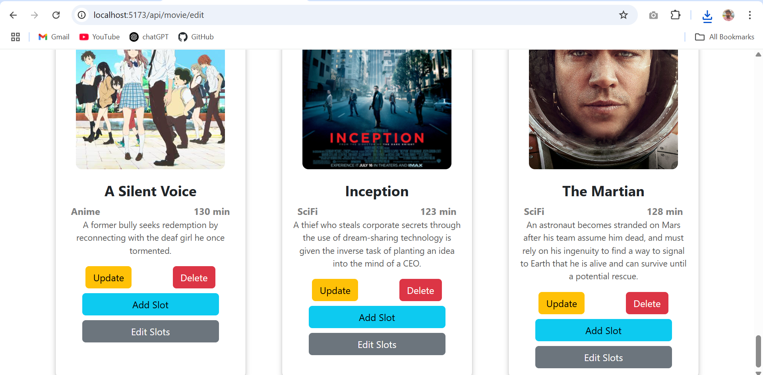
Editing The Martian

Slide 58
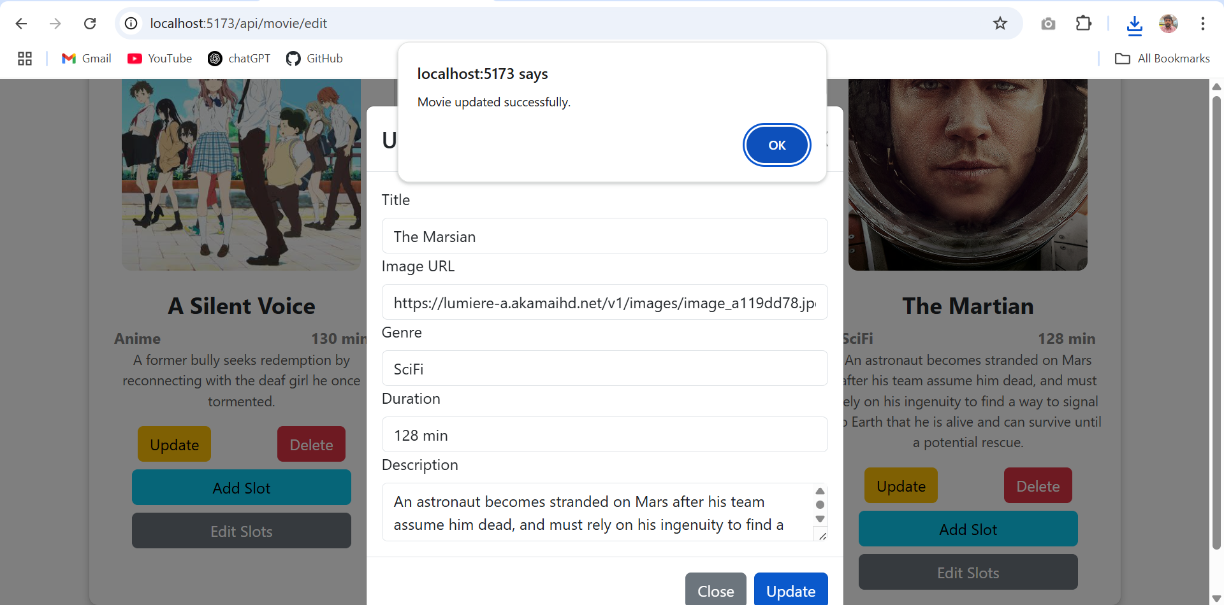
Editing Name

Slide 59
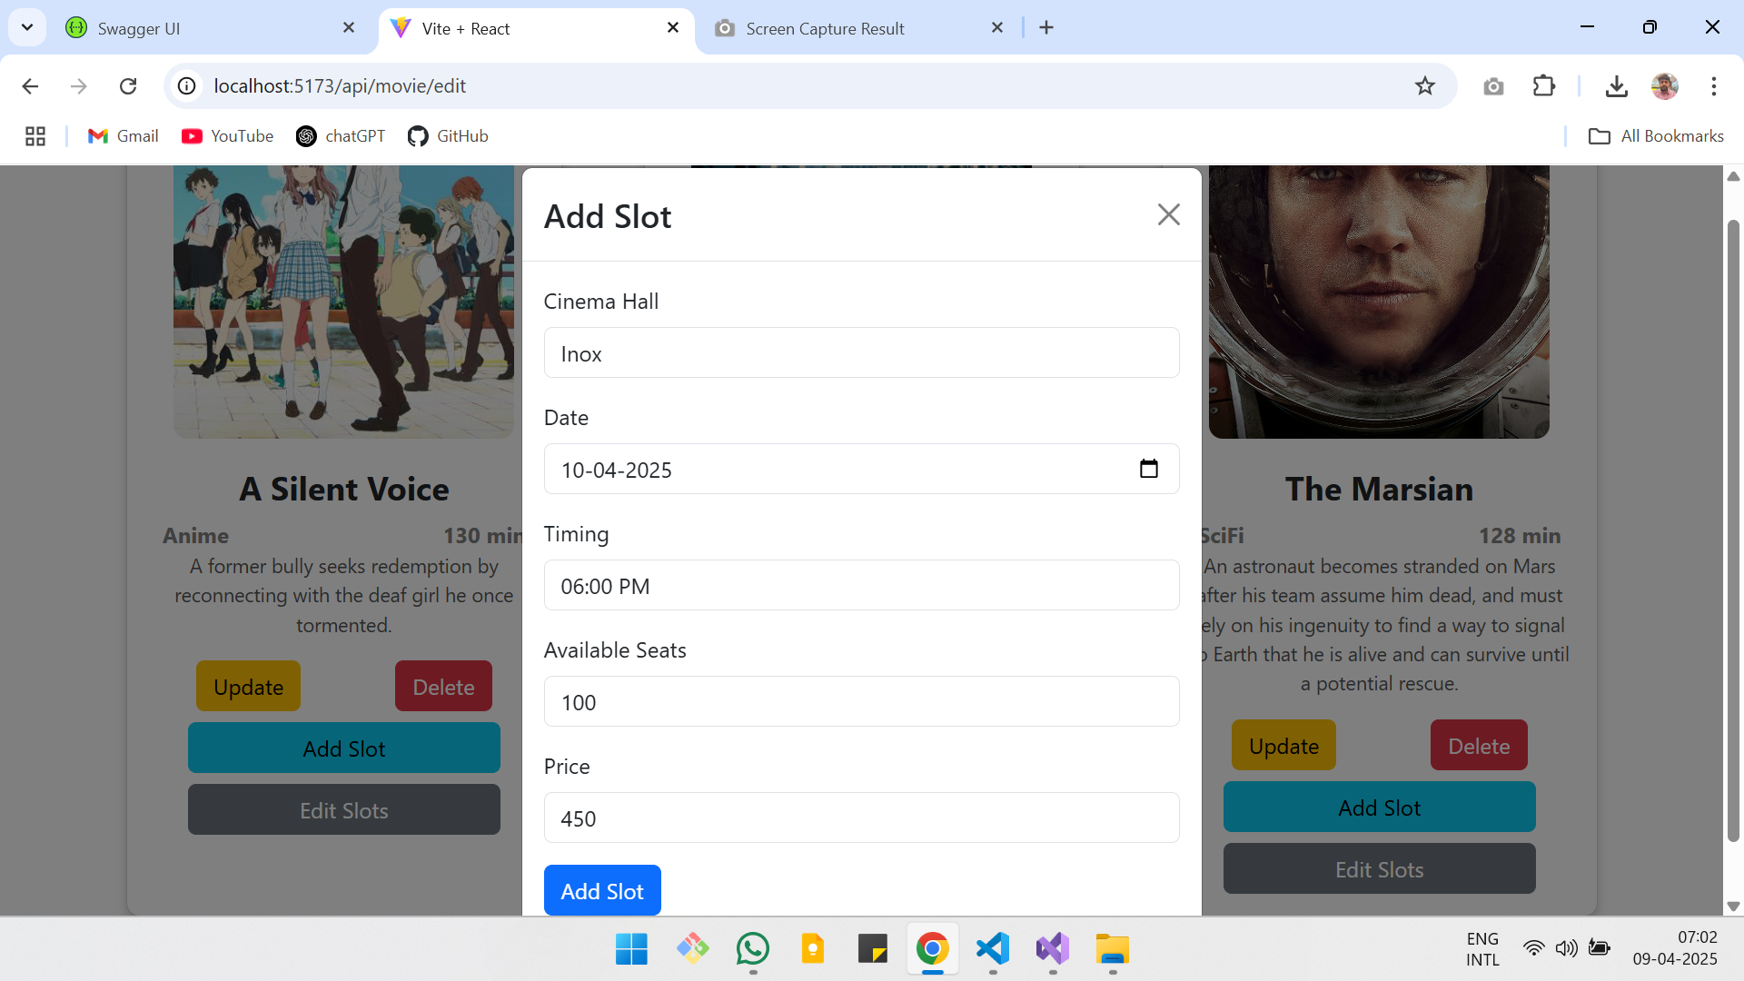
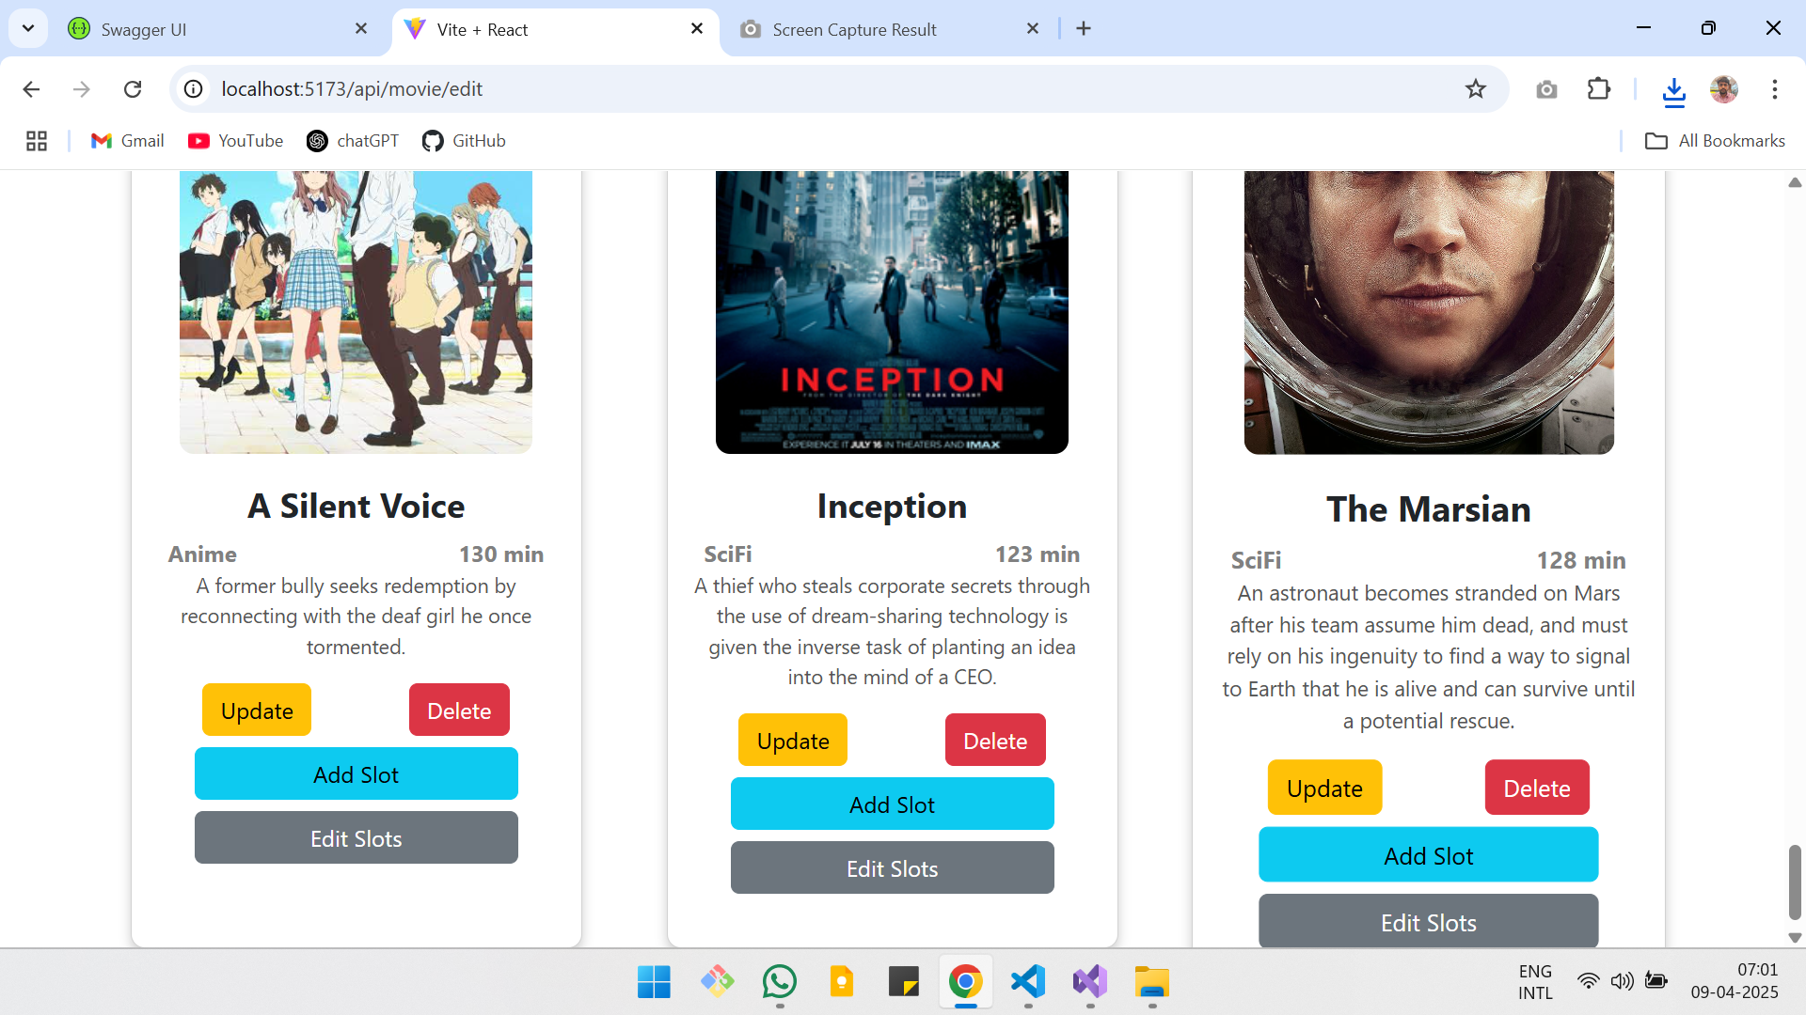

Slide 60
Add Slot

Slide 61
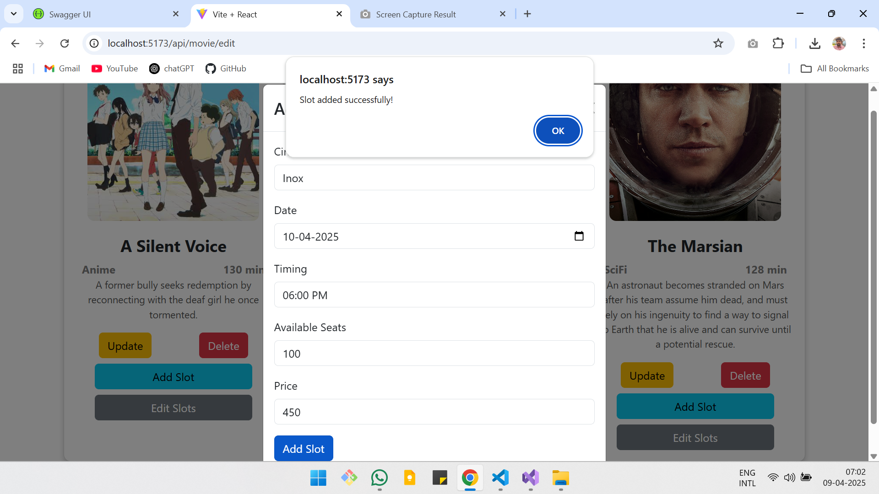

Slide 62


Slide 63

Edit Slot

Slide 64

Edit slot

Slide 65


Slide 66


Slide 67

Booking Ticket for the new slot

Slide 68


Slide 69


Slide 70


Slide 71

Slot deleted

Slide 72


Slide 73

Booking also Deleted due to FK

Slide 74

Movie Deleted

Slide 75


Slide 76

Manage Admin Access

Slide 77


Slide 78


Slide 79


Slide 80


Slide 81


Slide 82


Slide 83

Only default Admin exists.

Slide 84

User trying to Add movie

Slide 85


Slide 86
Video Demo

Slide 87
Thank You !!!

